Slide 1
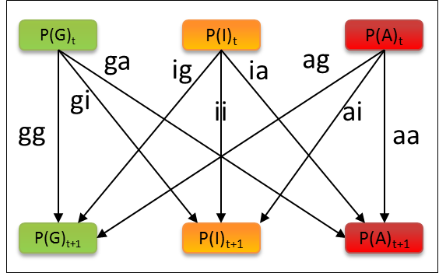
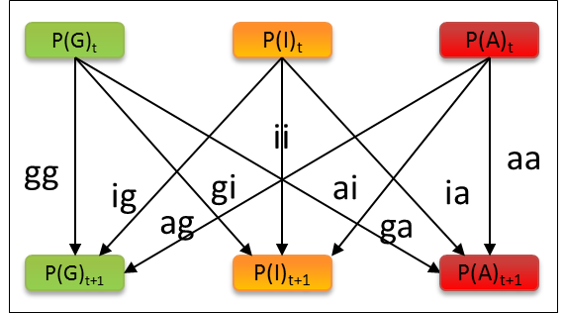
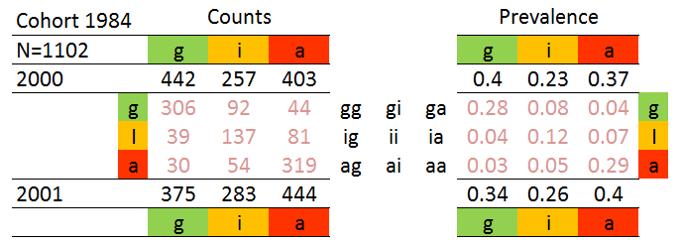
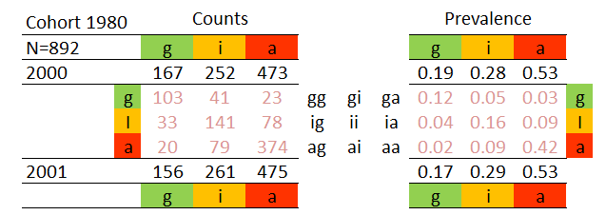
9 Transitions
6 Pairings

Slide 2
9 Transitions
Diffusion
Contagion
6 Pairings

Slide 3
9 Transitions
Diffusion
Contagion
6 Pairings

Slide 4
9 Transitions
Diffusion
Contagion
6 Pairings

Slide 6
9 Transitions
Diffusion
Contagion
6 Pairings

Slide 7
9 Transitions
Diffusion
Contagion
6 Pairings

Slide 8
9 Transitions
Diffusion
Contagion
6 Pairings

Slide 9
9 Transitions
Diffusion
Contagion
6 Pairings

Slide 11
9 Transitions
6 Pairings

Slide 13
Original EMOSA specification
alternative EMOSA specification
Hybrid
Contagion
Diffusion

Slide 14
Original EMOSA specification
alternativePlus EMOSA specification
Hybrid
Contagion
Diffusion

Slide 15
NewDiffusion
NewContagion
NewHybrid

Slide 16
.6
.3
.1
P(G)_{t}
P(I)_{t}
P(A)_{t}
P(G)_{t}
P(I)_{t}
P(A)_{t}
.36
.09
.01
ii
gg
aa
.18
.18
.03
.03
ig
gi
ai
ia
.06
.06
ag
ga
P(G)_{t+1}
P(I)_{t+1}
P(A)_{t+1}
P(G)_{t+1}
P(I)_{t+1}
P(A)_{t+1}
.36
.09
.01
.36
.06
.12
.46
Numerical Example
.54
1

Slide 18
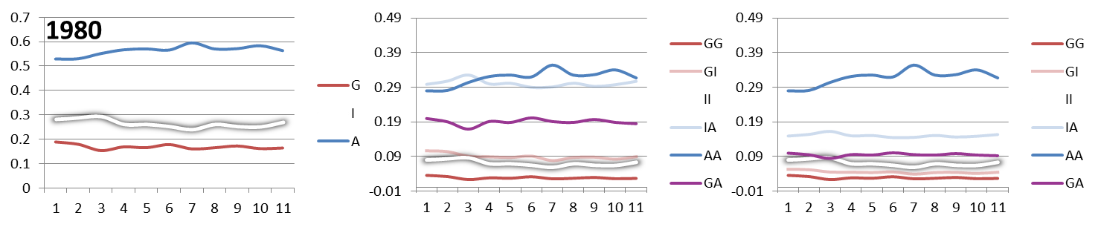

Slide 19
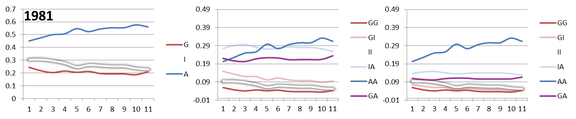

Slide 20
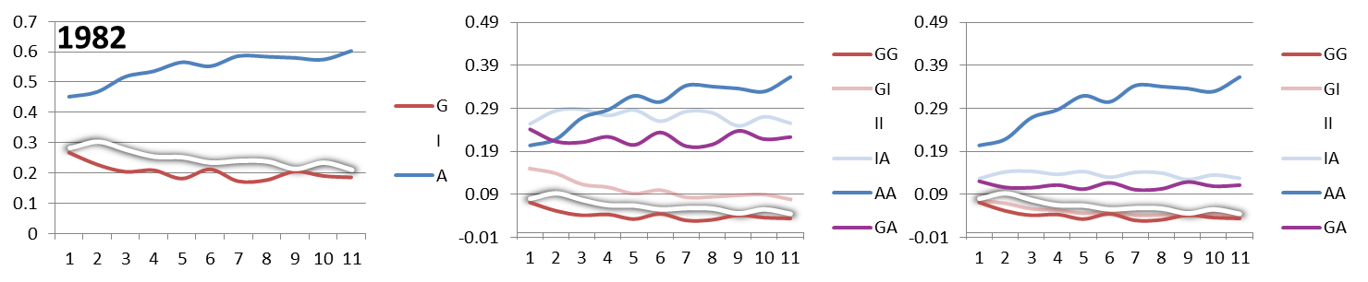

Slide 21
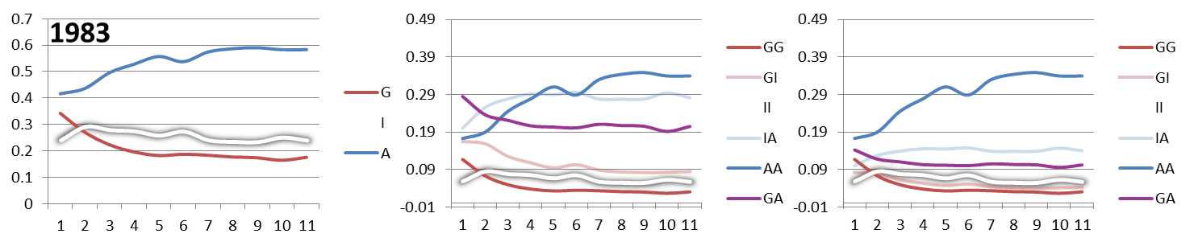

Slide 22
